Slide 1



Advanced Short Circuit Preventive Mechanism for Electric Vehicles
Submitted by
SHANJAY R K | (927621BEC195)
SIVARAMAKRISHNAN M | (927621BEC201)
SUBASH P | (927621BEC213)
YASAR S | (927621BEC245)
Guided By
Dr.K.Sheikdavood (AP/ECE)

Slide 2
Abstract
Our project introduces an advanced short circuit prevention mechanism for electric vehicles, focusing on improving safety, reliability, and performance. Traditional protection methods like fuses and circuit breakers are reactive and insufficient for modern EVs. Our system uses high-speed monitoring, machine learning algorithms, and intelligent control to proactively detect and prevent faults. The design is scalable and modular, making it suitable for various EV platforms. By enhancing system resilience and reducing maintenance costs, this solution supports the safe, efficient, and sustainable growth of electric mobility.

Slide 3
Introduction
Growing Global EV Adoption As electric vehicles (EVs) continue to grow in popularity, ensuring the safety of users has become increasingly important.
Safety Concern Short circuits in EVs can lead to system failures, component damage, and pose significant safety risks to users.
Current Protection Limitations Traditional methods like fuses and circuit breakers are slow and reactive, which leaves EVs vulnerable to short circuits.
Our Solution present a proactive short circuit prevention system that utilizes high-speed monitoring, machine learning, and intelligent control to detect and prevent faults in real-time.

Slide 4
Literature Review Table
Author | Title | Year of published | Drawback
D. Qiao et al | "Quantitative Diagnosis of Internal Short Circuit for Lithium-Ion Batteries Using Relaxation Voltage" | 2024, IEEE Transactions on Industrial Electronics | Focuses primarily on diagnosis without providing real-time mitigation strategies for detected faults.
Z. Sun et al. | "An Online Data-Driven Fault Diagnosis and Thermal Runaway Early Warning for Electric Vehicle Batteries" | 2022, IEEE Transactions on Power Electronics | Limited to battery systems; lacks consideration of external factors like environmental conditions.
F. Kaya and O. Akar | "Short Circuit Effects on HV Feeders of Optimally Located Electric Vehicle Fast Charging Stations" | 2024, IEEE Access | Addresses stationary systems only; does not factor in dynamic or mobile EV charging scenarios.

Slide 5
Literature Review Table
Author | Title | Year of published | Drawback
H.-C. Park et al. | "Design and Evaluation of High-Speed Overcurrent and Short-Circuit Detection Circuits With High Noise Margin for WBG Power Semiconductor Devices" | 2024, IEEE Access | Focuses on device-level protection circuits lacks application to large-scale EV systems or grid-connected setups.
D. Walch et al. | "Inter-Turn Short Circuit Faults and Mitigation Measures for Dual-Three Phase Machines" | 2024, ICEM Conference | Limited to specific machine configurations applicability to other motor types or EV systems not explored.
I. Husain et al. | "Electric Drive Technology Trends, Challenges, and Opportunities for Future Electric Vehicles" | 2021, Proceedings of the IEEE | Broad overview of trends does not provide deep technical insight into fault detection or mitigation strategies.

Slide 6
Existing System
Existing system uses a basic power supply that sends electricity directly to the vehicle without checking for problems.
Fuses and circuit breakers are used to stop power only after a short circuit happens.
These safety parts work slowly and only react after damage may have already started.
There is no smart control or real-time monitoring, which means the system cannot prevent faults early.

Slide 7
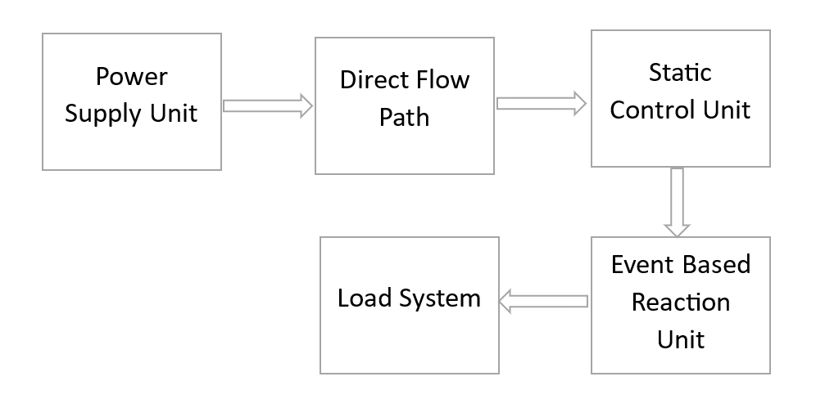
Block Diagram of Existing System

Slide 8
Problem Statement
Electric vehicles are prone to short circuits due to cell imbalance, overcurrent, insulation failure, and thermal runaway.
These faults can cause severe safety risks, system failures, and damage to components.
Conventional methods like fuses and breakers react slowly and lack real-time fault detection.
A smart, high-speed system is needed to pro actively detect and prevent short circuits in Evs.

Slide 9
Objective
Our project aims to develop a proactive safety system for electric vehicles (EVs) that detects and prevents short circuits using machine learning and high-speed monitoring. It focuses on addressing key issues such as cell imbalance, overcurrent, insulation failure, and thermal runaway. The goal is to enhance system performance and user safety while promoting sustainable EV adoption through advanced fault prevention. The system will replace conventional reactive methods with intelligent, adaptive control solutions tailored for modern EV platforms.

Slide 10
Proposed Methodology
Sensor Data Collection
Cell Imbalance Detection
AI-Based Predictive Analytics
Automated Circuit Isolation Mechanism
Real-Time Monitoring
Cloud Storage
Alert and Safety Mechanism

Slide 11
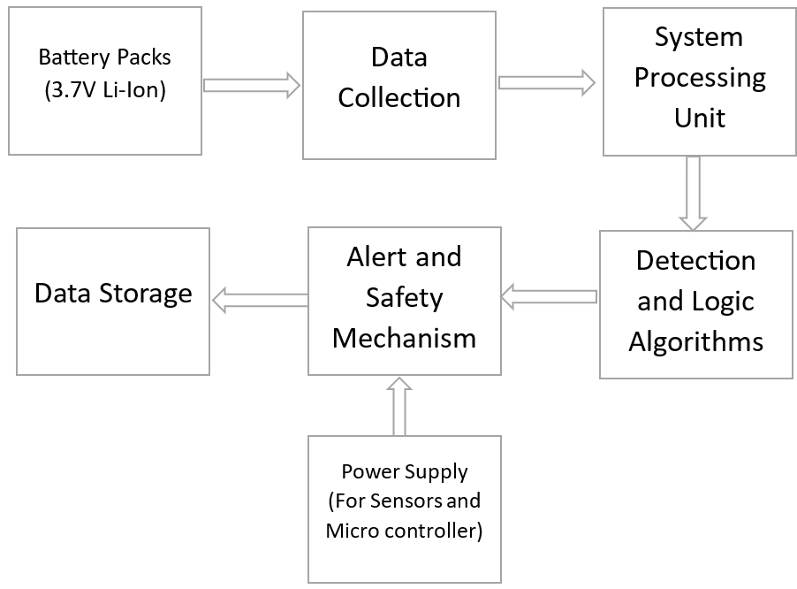
Block Diagram of Proposed System

Slide 12
Advantages
Early Detection of Short Circuits
Detects Cell Imbalance Accurately
Automated circuit Isolation avoid damage
Cloud storage enables remote monitoring

Slide 13
Application
Predictive Maintenance Platform
Battery Safety Solutions
Cloud Based Monitoring Systems
Autonomous and Connected Vehicles
Battery Energy Storage System

Slide 14
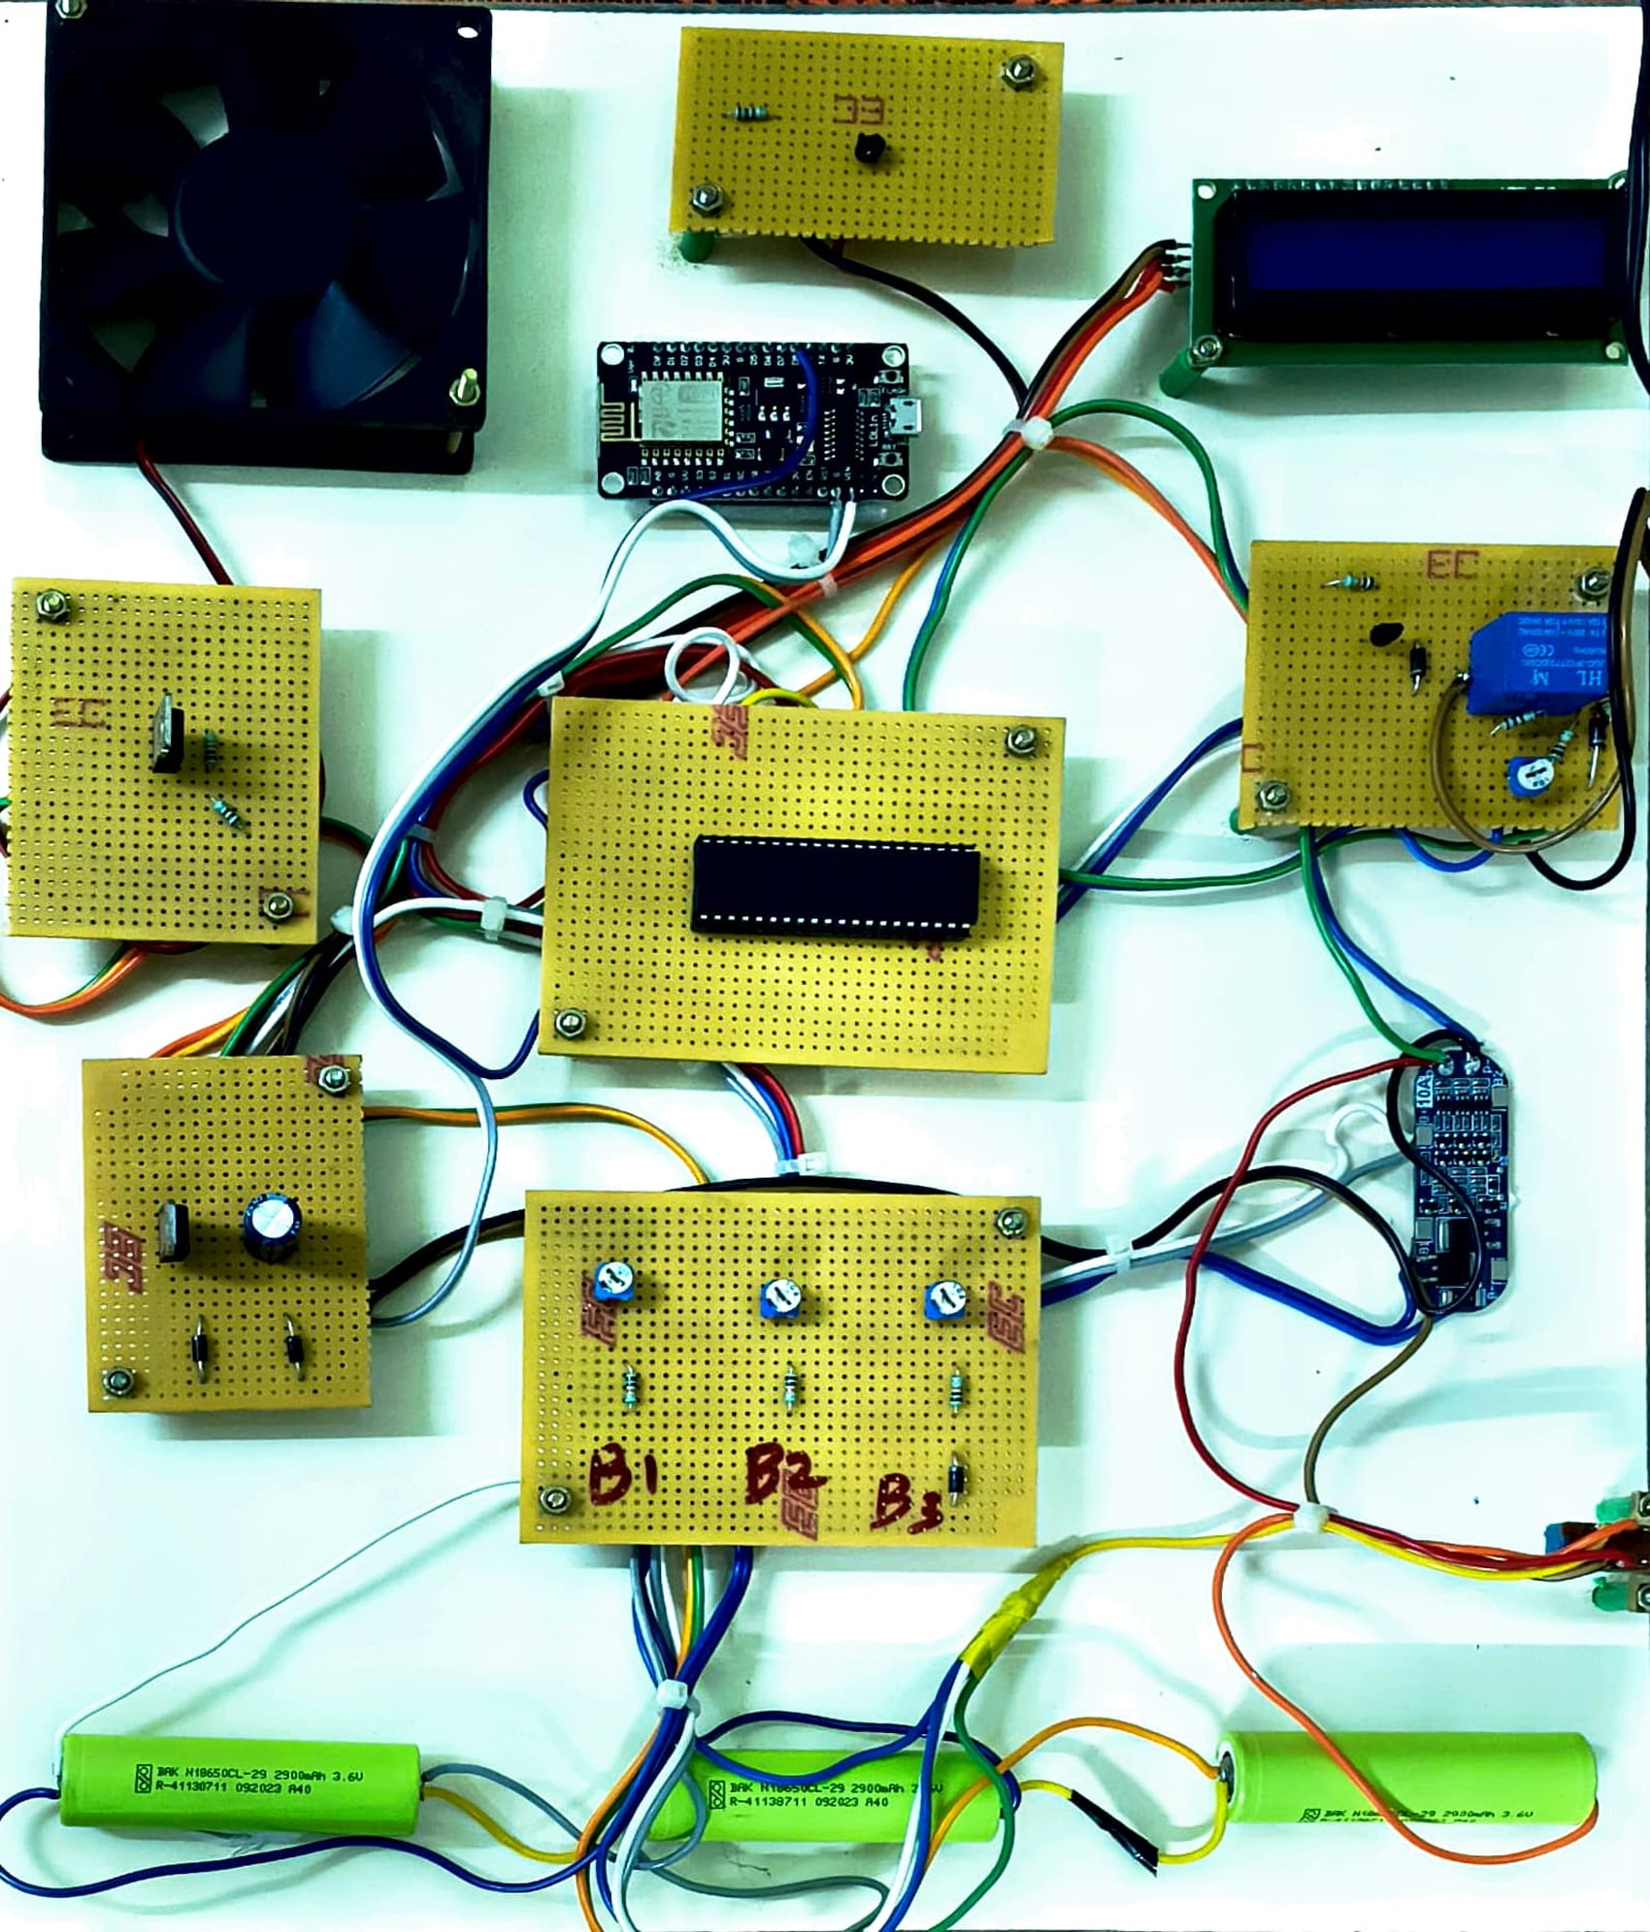
Results and Discussions

Slide 15
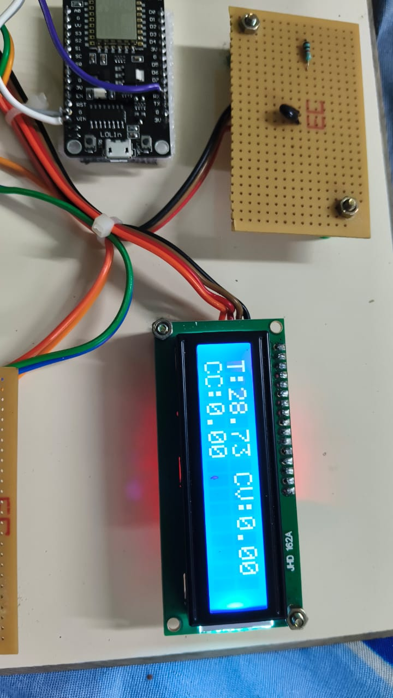
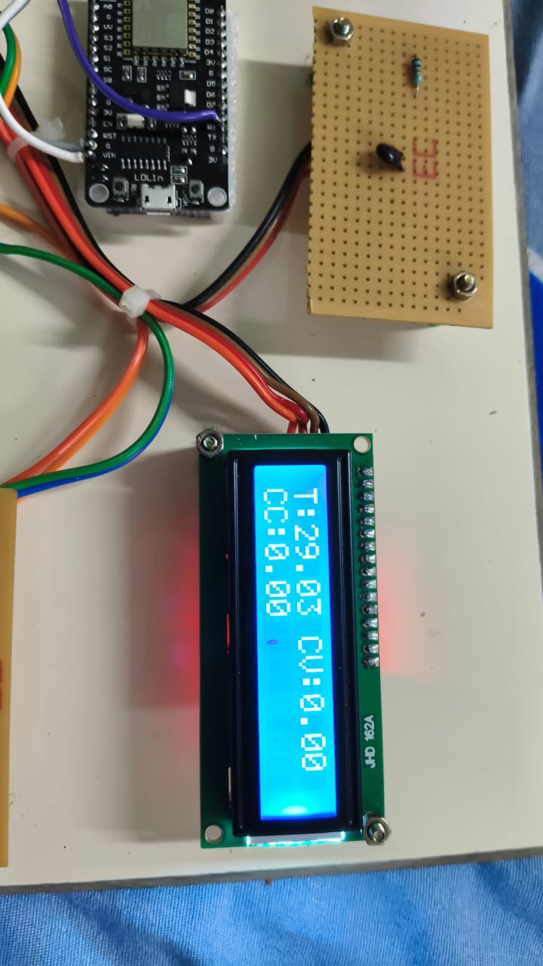
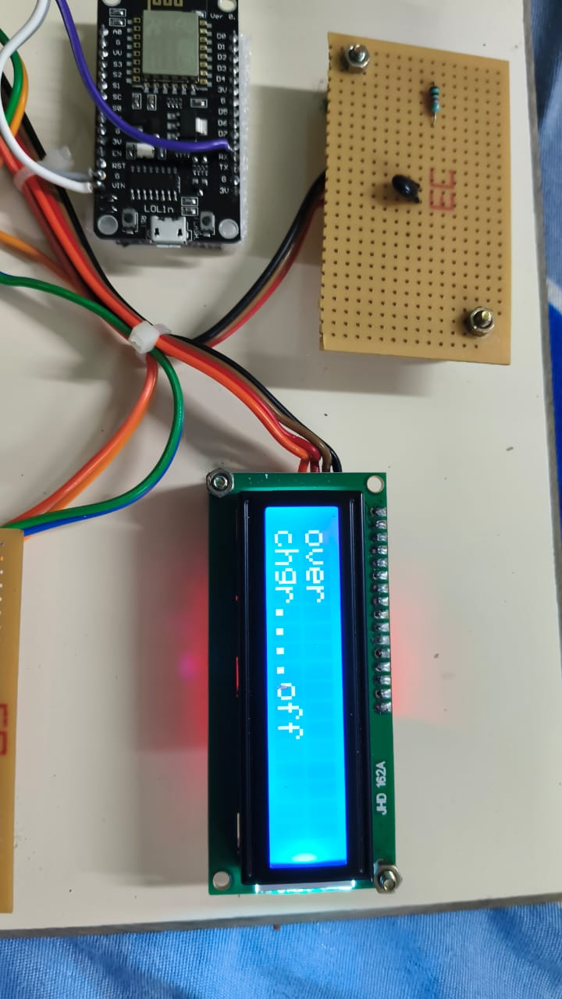
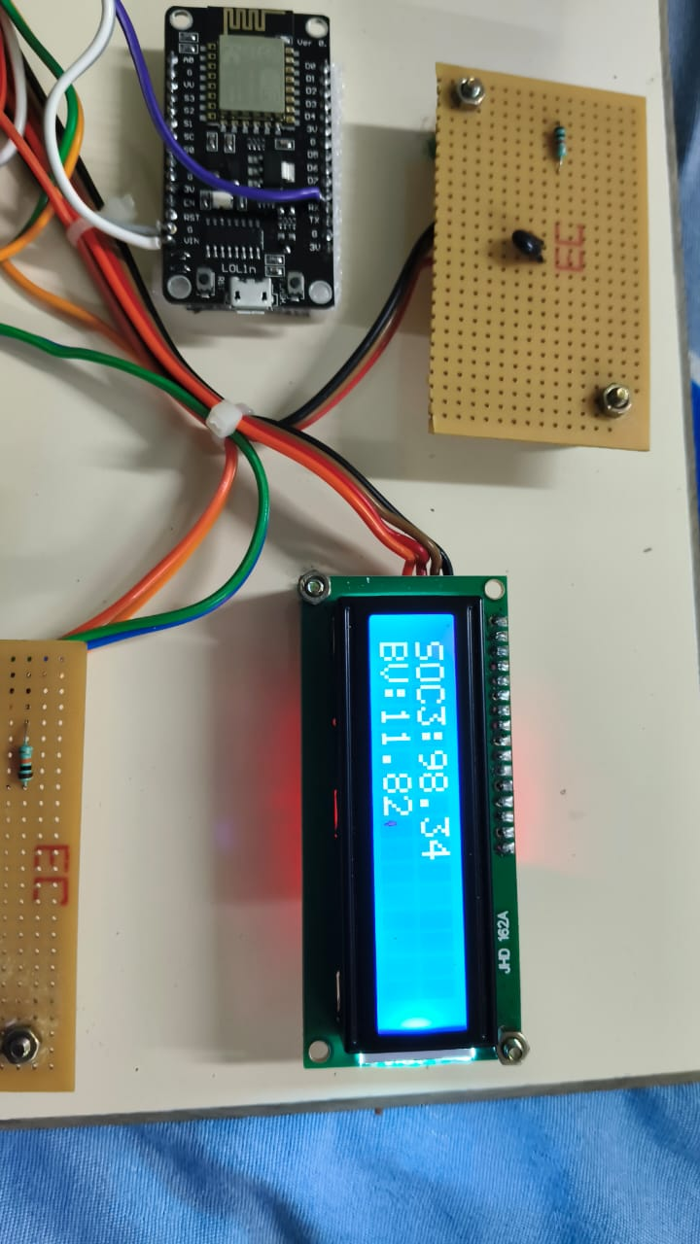
Battery Performance Monitoring

Slide 16
Conclusion
Our project presents an intelligent and proactive safety mechanism for electrical systems, utilizing AI-based predictive analytics and real-time monitoring to detect and prevent short circuits effectively. By addressing key issues like cell imbalance, overcurrent, and thermal risks, the system ensures enhanced safety, reliability, and efficiency. With automated control and cloud-based data handling, this solution marks a significant step towards smarter and safer energy systems, supporting the future of sustainable electric mobility.

Slide 17
Reference
[1] D. Qiao et al., "Quantitative Diagnosis of Internal Short Circuit for Lithium-Ion Batteries Using Relaxation Voltage," in IEEE Transactions on Industrial Electronics, vol. 71, no. 10, pp. 13201-13210, Oct. 2024,doi: 10.1109/TIE.2023.3342289.
[2] D. Walch, A. Geiger and C. Sültrop, "Inter-Turn Short Circuit Faults and Mitigation Measures for Dual-Three Phase Machines," 2024 International Conference on Electrical Machines (ICEM), Torino, Italy, 2024, pp. 1-7, doi: 10.1109/ICEM60801.2024.10700240.
[3] I. Husain et al., "Electric Drive Technology Trends, Challenges, and Opportunities for Future Electric Vehicles," in Proceedings of the IEEE, vol. 109, no. 6, pp. 1039-1059, June 2021,doi: 10.1109/JPROC.2020.3046112.
[4] A. Jose, A. M. Varghese, F. E. Jenson, P. Jacob, D. M. Anumod and D. Thomas, "Solid-State Circuit Breaker based Smart Distribution Board with IoT Integration," 2020 Third International Conference on Smart Systems and Inventive Technology (ICSSIT), Tirunelveli, India, 2020, pp. 54-61, doi: 10.1109/ICSSIT48917.2020.9214172.

Slide 18


Conference Details

Slide 19

Conference Details

Slide 20
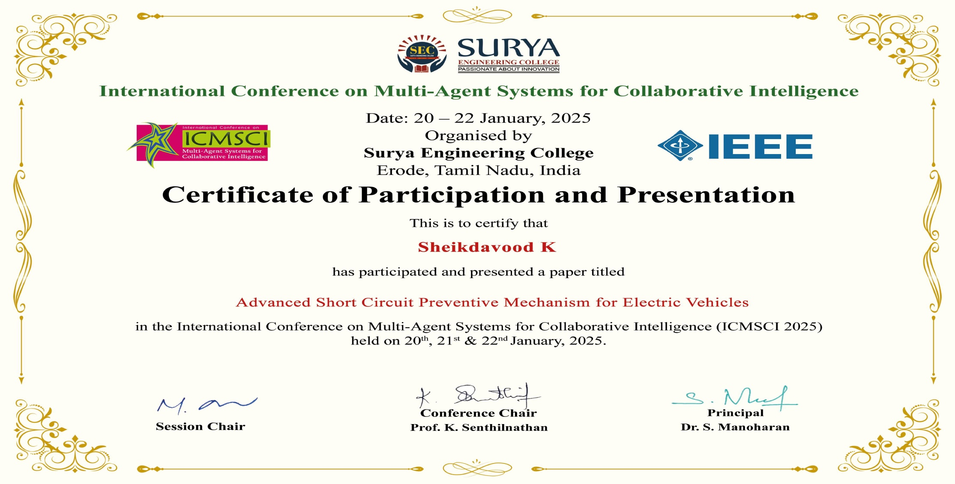
Project Outcome Status
.

Slide 21

.
.

Slide 22

.
.

Slide 23

.
.

Slide 24

.
.

